Slide 1
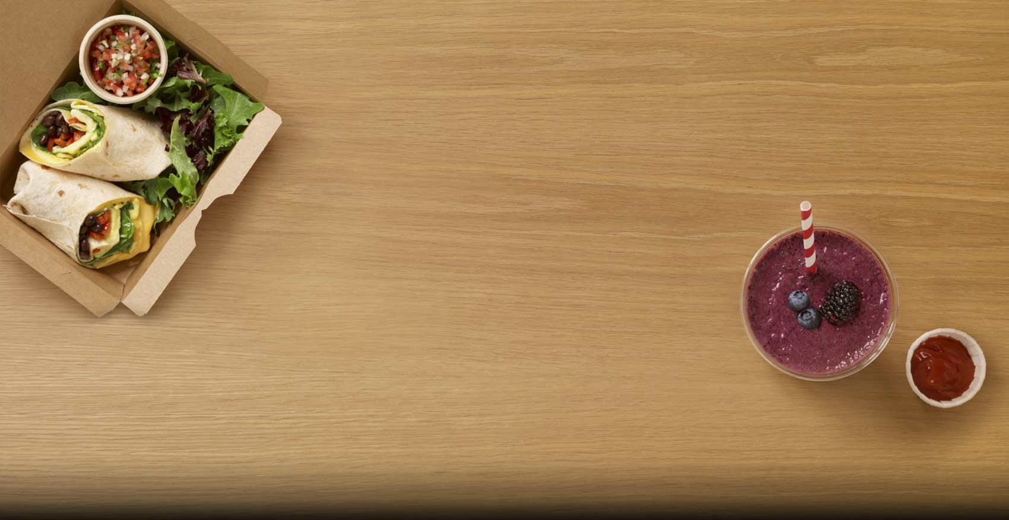
Food Sales
Data Analysis
Analysis by Andy Gomez | 07/2021

Slide 2

Background – Food Data
Number of Food Items: n=8523
Some of the collected metrics include:
Item Identifier
Item Weight
Item Fat Content
Item Type
Item MRP
Item Outlet Sales

Slide 3

Executive Summary – TL;DR
Overall Trends found for Food Sales
Overall, item that a low in fat content have higher total sales than items with regular fat content
Supermarket Type 1 is the outlet type that has garnered the most sales
There is a moderate positive correlation between Item MRP and Item Sales
After testing several predictive models (KNN, Bagging Regressor, Random Forest Regressor):
K-Nearest Neighbors produced the strongest test R^2 value of .51
Bagging Regressor had a test R^2 score of .28 and Random Forest Regressor had a score of .35 (Note: these two predictive methodologies used train-test-split)

Slide 4
Recommendations
Actionable Items
Finding a way to incorporate elements from supermarket Type 1 stores into the other types of markets can potentially help garner more sales
Due to the positive correlation of Item MRP and Item Sales, increasing the MRP of Regular fat content food items can potentially increase Item sales
Using K-Nearest Neighbor to help predict future food item sales would be a decent model to use over other regression predictive models.

Slide 5

Data

Slide 6
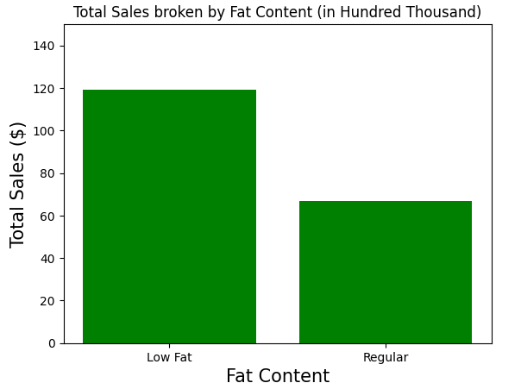
Food Items with low fat content sell almost double the amount when compared to items with regular fat content

Slide 7
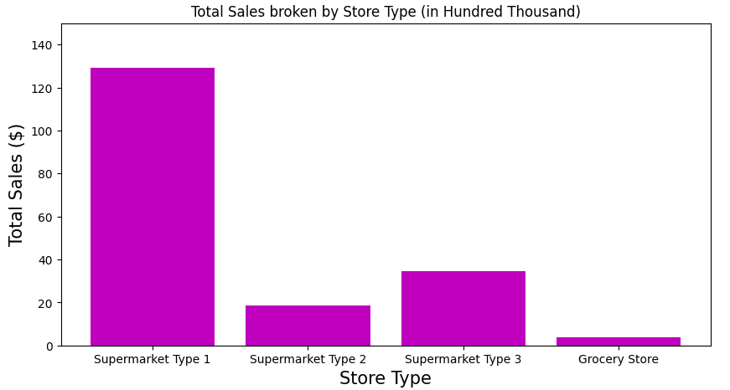
Supermarket Type 1 is the clear winner when it comes to Total Sales

Slide 8
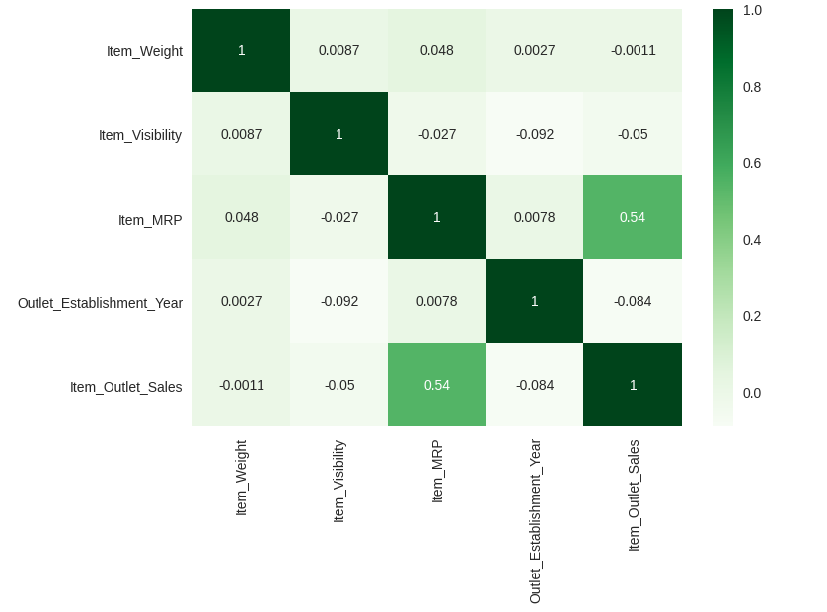
Item MRP and Item Sales have a moderate positive correlation score of .54

Slide 9
K-Nearest Neighbor is seen to be a stronger predictive model for food item sales when compared to other Regressor models
K-Nearest Neighbor Score
R^2 = .51
Bagging Regressor Scores | Random Forest Regressor Scores
Train R^2 = .88 | Train R^2 = .91
Test R^2 = .28 | Test R^2 = .35

